Slide 1
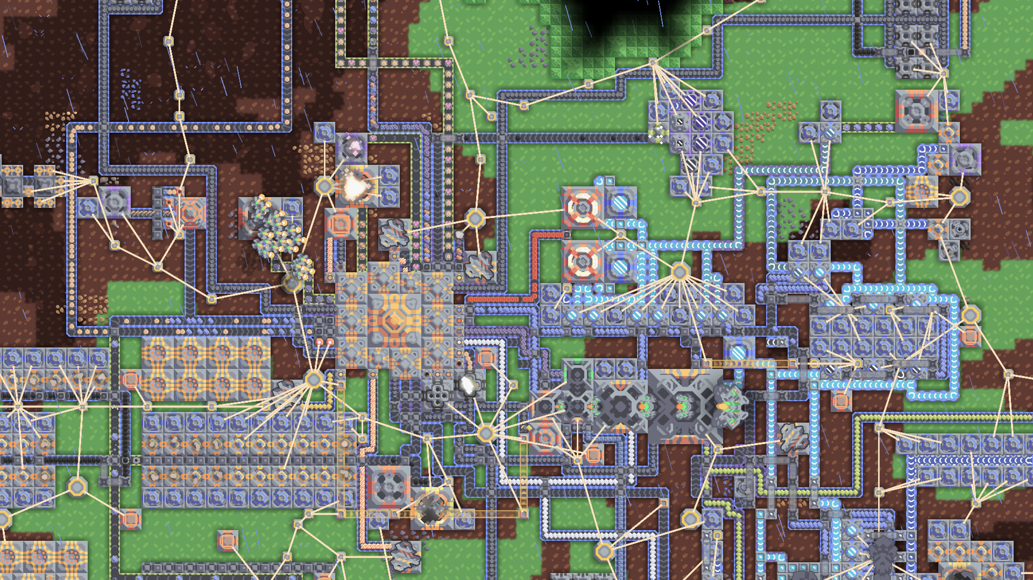


Slide 2
Sprint 1

Slide 3
Backlog
Student ID
Story
To Do
Doing
Review
Done
US1: [...]
US1: [...]
T1: [...]
Student #1
US2: [...]
Student #2
US1: [...]
T2: [...]
Student #3
Student #4
Student #5
Student #6

Slide 4
Backlog
Student ID
Story
To Do
Doing
Review
Done
US1: [...]
US1: [...]
T1: [...]
Student #1
US2: [...]
Student #2
US1: [...]
T2: [...]
Student #3
Student #4
Student #5
Student #6

Slide 5
Backlog
Student ID
Story
To Do
Doing
Review
Done
US1: [...]
US1: [...]
T1: [...]
Student #1
US2: [...]
Student #2
US1: [...]
T2: [...]
Student #3
Student #4
Student #5
Student #6

Slide 6
Backlog
Student ID
Story
To Do
Doing
Review
Done
US1: [...]
US1: [...]
T1: [...]
Student #1
US2: [...]
Student #2
US1: [...]
T2: [...]
Student #3
Student #4
Student #5
Student #6

Slide 7
Backlog
Student ID
Story
To Do
Doing
Review
Done
US1: [...]
US1: [...]
T1: [...]
Student #1
US2: [...]
Student #2
US1: [...]
T2: [...]
Student #3
Student #4
Student #5
Student #6

Slide 8
Sprint 2

